Slide 1

Bank Marketing Project
Data Science Track
15/08/2021

Slide 2
Bank Marketing Project
Group Name: Data Science Group
Names:
1. Boshra Abdulrahman Eisa
2. Omer Salih Dawood Omer
Email: bush.eisa9@gmail.com , omercomail@gmail.com
Country: Saudi Arabia

Slide 3

Agenda
Executive Summary
Problem Statement
Approach
EDA
EDA Summary
Recommendations

Slide 4
Executive Summary
The Objective:
Distinguish between customers who are likely to subscribe to the bank’s product.
The Procedure :
Analyse the bank’s customers, the patterns on their data and the predict the likelihood of them subscribing.

Slide 5
Problem Statement
ABC Bank wants to sell its term deposit product to customers and before launching the product they want to develop a model which help them in understanding whether a particular customer will buy their product or not (based on customer's past interaction with bank or other Financial Institution).

Slide 6
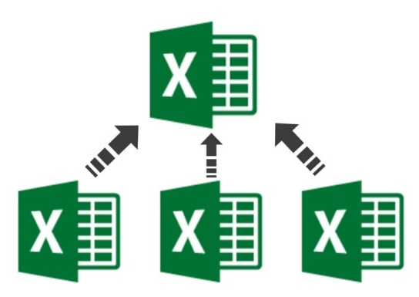


Approach
Using a machine learning algorithm, we will be able to create a list of customers who are more likely to buy the product. This is based on multiple parameters like their job, housing, and loans. This algorithm will be able to predict ideal customers thus allowing the bank to focus its resources on customers who would be interested in buying their product instead of wasting time and resources.
Develop machine learning model to:
Select customers that may buy the products.
Use minimum set of resources and save time to select candidate customers
Increase business profits.
By using available datasets and apply machine learning algorithm to automate process of customer selection, the candidate customers will be identified easily. No need to use any resources in customer’s side. Only in server side we need to run software.

Slide 7
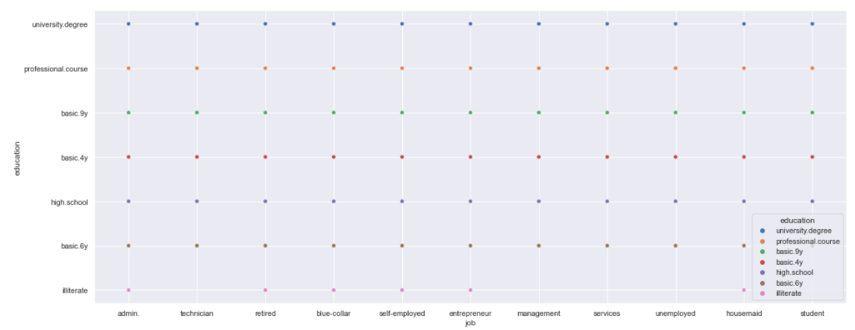
EDA

Slide 8
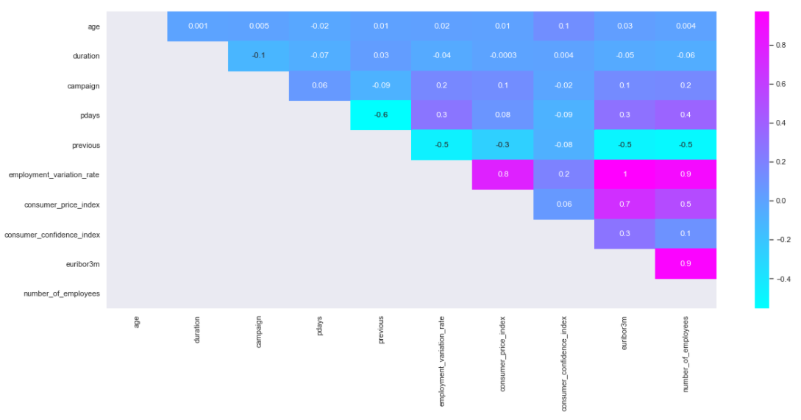
EDA

Slide 9
EDA Summary
We used the provided dataset to pick the ideal customer for the bank to focus its time and resources on. The data needed a little bit of preprocessing so it would fit nicely into the predictive machine learning algorithms.

Slide 10
Recommendations
We’ve used several predictive machine learning algorithms, which are:
KNN, Decision Tree, Random Forest, Naïve Bayes, Logistic Regression and Support Vector Machine.
The following is the scores of each algorithm:
The Algorithm | The Score
KNN | 0.9077445982034474
Decision Tree | 0.9089584850691915
Random Forest | 0.9082301529497451
Naive Bayes | 0.7921825685846079
Logistic Regression | 0.9078659868900218
Support Vector Machine | 0.902889050740471
Thus, we recommend using the Decision Tree algorithm because it produces the most accurate results

Slide 11
Thank You

